Slide 1
Economics of Power Generation

Slide 2
Single Payment Factors
Compound Interest Factor (CIF)
Present Value Factor (PVF)

Slide 3
Uniform Series Payment
Present Worth Factor (PWF)
Capital Recovery Factor (CRF)
Compound Amount factor (CAF)
Sinking Fund Factor (SFF)

Slide 4
Relationship Between Factors
F = CIF*P = CIF *PWF*R=CAF*R
R = P*CRF = (PVF*F)*CRF = SFF*F
CRF = i+SFF

Slide 5
Levelized Cost
For inflation series
For any future payments (Multiply CRF with present value of all payments).

Slide 6
Levelized Cost Analysis of a Power Plant

Slide 7
Example for Levelized Cost Calculation
Plant Capacity 400MW
Heat Rate 9500Btu/KWh
Fuel Cost 2$/MBtu
Plant Cost 1500 $/kW
O&M Cost Fixed 20$/kW/year
O&M Cost Variable 5$/MWh
Levelized Fixed Charge Rate 0.2/year (20%)
Discount Rate (10%)
Fuel Price Inflation (6%)
Capacity Factor 0.7

Slide 8
FCR Calculation
Annual Fixed Charges = Interest + Net Income +Book Depreciation +Ad Valorem Charges +Income Tax
Deferred Income Tax and Income Tax credit etc.
Levelizing the charges leads to FCR.

Slide 9
Discount Rate
Common Stock
Preferred Stock
Bond
Income is return on common and preferred stock
Interest is on bond

Slide 10
FCR Components
Ad Valorem (Tax or payments based on value)
Depreciation
Income + Interest
Income Tax

Slide 11
Example for FCR calculation
Bond Interest Rate 10%
Debt Ratio 50%
Preferred Stock Dividend Rate 12%
Preferred Stock Fraction 10%
Common Stock Earning Rate14.5%
Common Stock Fraction 40%
Income Tax Rate 38%
Property Tax and Insurance 3% (Levelized)
Depreciation Life 30 years

Slide 12
Load Curve

Slide 13
Load Duration Curve

Slide 14
Definitions
Peak load
Average Load-- total energy/time duration
Load factor (System load factor)-- average load/peak load
Capacity factor (Plant load factor, PLF)
average load/plant capacity
Total energy produced/maximum energy production possible

Slide 15
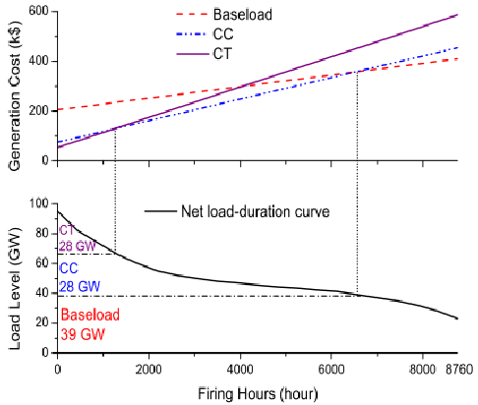
Screening Curve

Slide 16
LCOE
Levelized Cost of Electricity
Total Annual Cost/Total Annual Energy

Slide 17
Chapters
All topics are from “Least Cost Electric Utility Planning” by Harry G. Stoll
Chapter 3 (Time value of money) can also be covered by link sent earlier
Chapter 4 (Page 52-73) Mainly Fixed Charge Rate calculation
Chapter 14 (Page 494-505) Levelized Cost and Screening Curve

